Slide 1

Making you aware

Slide 2
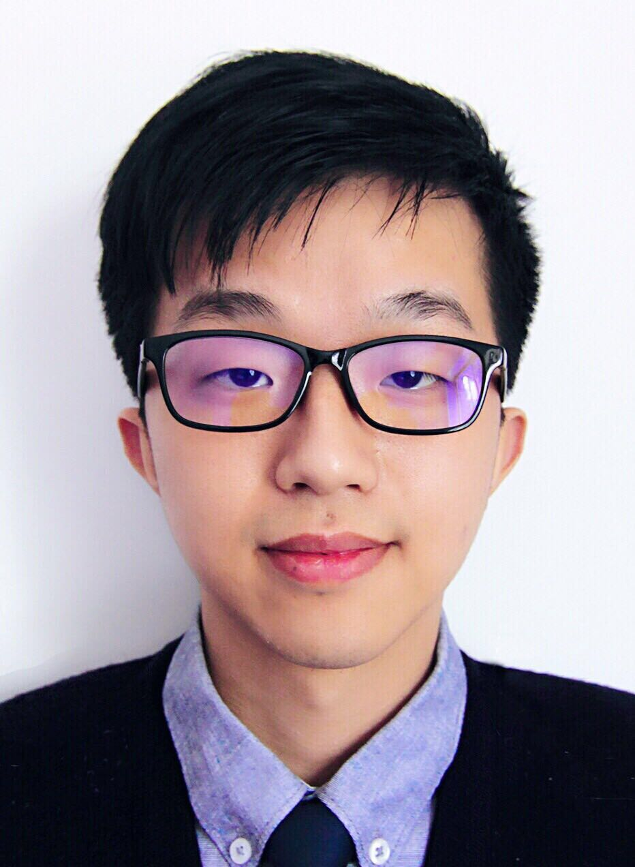
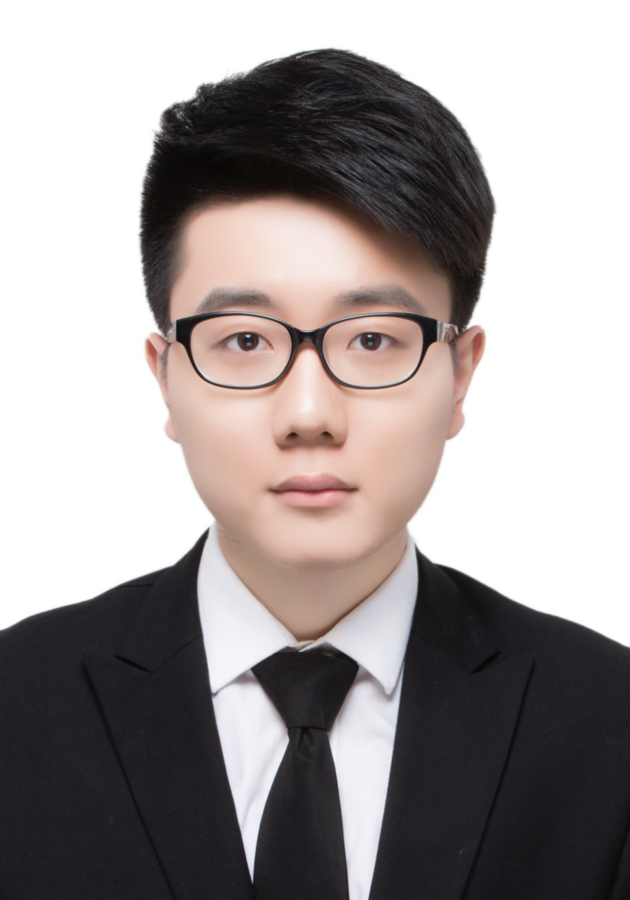
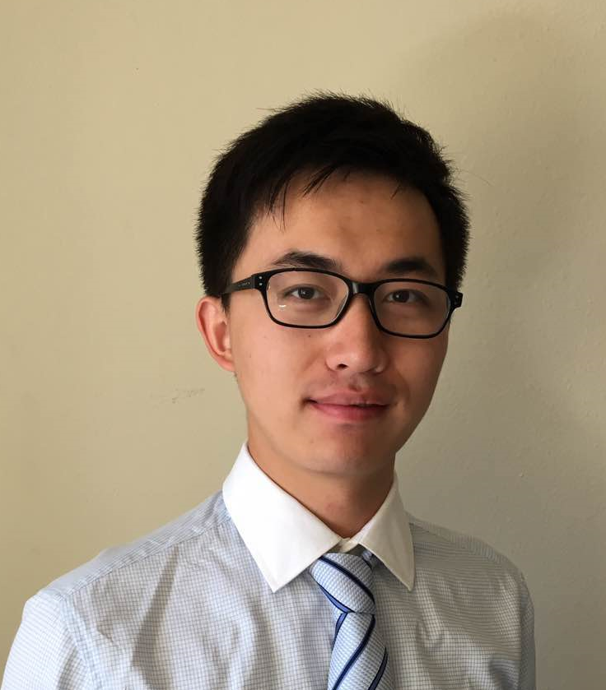
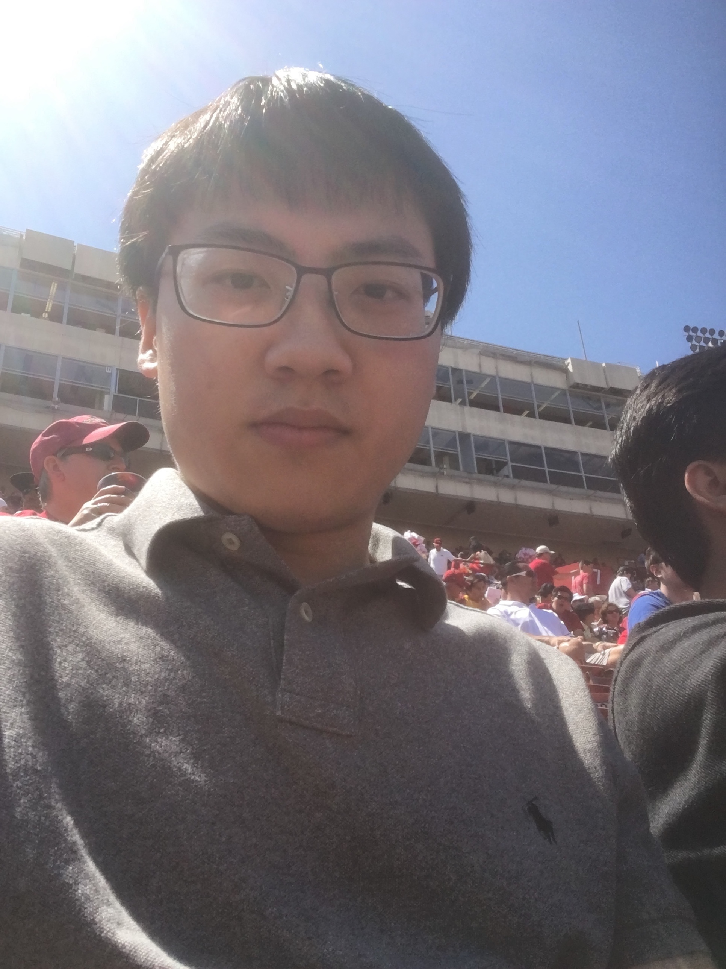
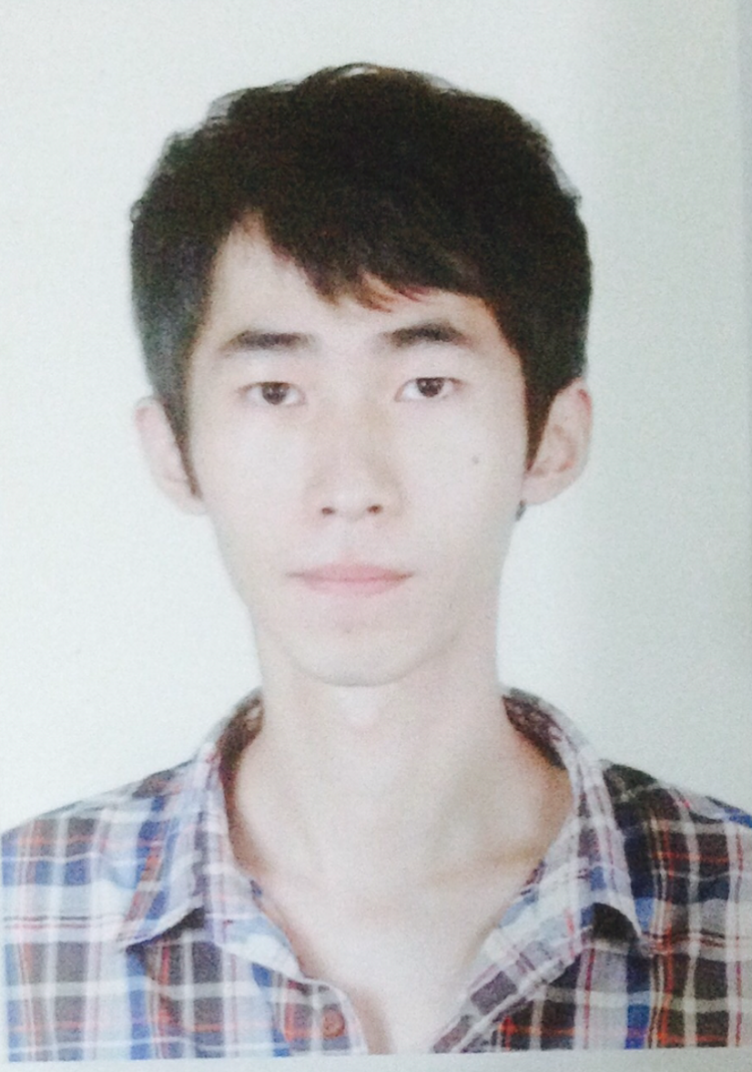
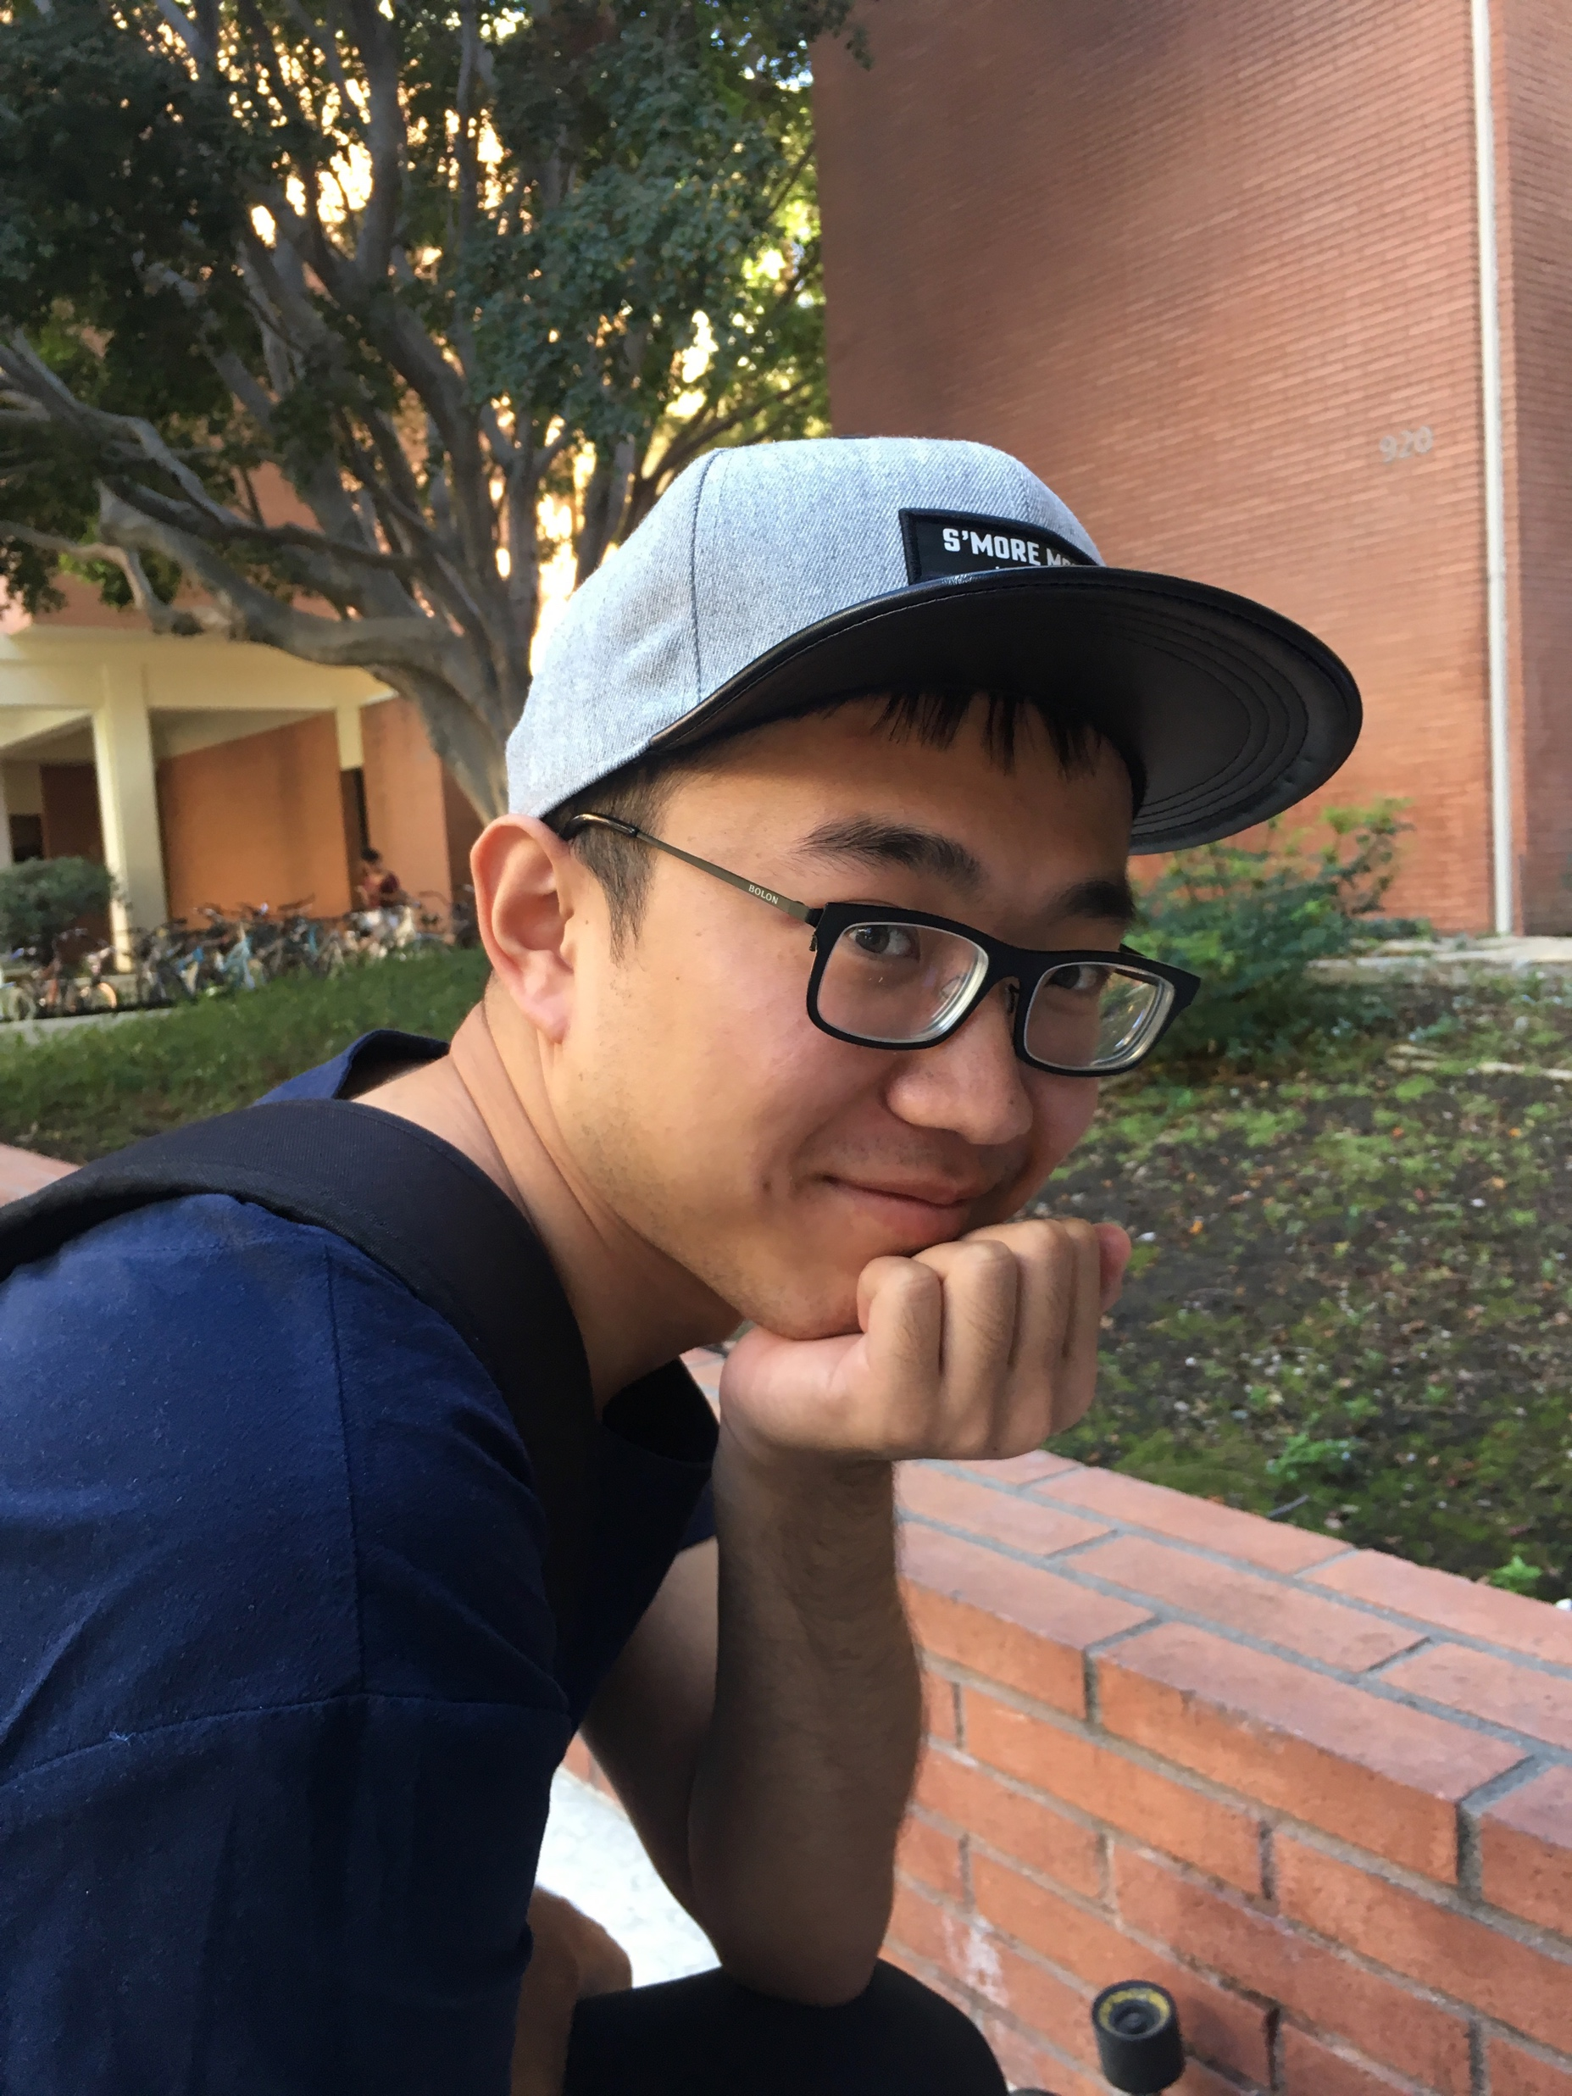
:.: Team
Shiji Zhou
Chengyu Shen
Yang Wei
Lin Xia
Guanghe Cao
Yufei Hong

Slide 3
:.: Overview
Background
1. Populic is a map with information what is happening around you
2. Share photos/videos to the map
Current problem
1. How to attract more college students to join the actives
2. How to promote the pictures/videos uploads
3. How to add user adhesion
Our job
1. build challenge function to increase the number of uploads
2. design the score system to attract more users to join the community

Slide 4
:.: Core capabilities
Challenge functionality
1. Users can check daily challenge
2. Users can send/receive the challenge task to their friends
3. Users can post the challenge tasks
4. Users can judge challenges tasks
Score functionality
1. Users can use score to buy fancy items
2. Users can check sore rank
Invite functionality
1. Allow users invite friends from contact list

Slide 5
:.: personas
Name: Annie
Age: 22
Gender: Female
Location: near USC campus
Motivation/user scenario: Annie is 22 years old senior who has a lot of friends. She wants getting close with all her friends through challenge game.
Computer Literacy / technical lifestyles: Annie uses her iPhone everyday for texting calling sending emails and playing games.
Copied by Google image

Slide 6

:.: personas
Name: Jason
Age: 18
Gender: Male
Location: near USC campus
Motivation/user scenario: Jason is 18 years old freshman. He wants to get involved in college life with peers through some funny challenge tasks (as ice breaker games) with new friends.
Computer Literacy / technical lifestyles: Jason uses his iPhone everyday for social applications.
Copied by Google image

Slide 7
:.: Reason for Prototype
Inexpensive — It’s acceptable to fail early
Explore feasibility:
Which external systems can we integrate?
Which functions are too complicated to realize on time?
Gather more accurate requirement.
Risk

Slide 8
:.: Risk
Risk 1: How can a user participant in challenge if he/she didn’t receive invitation before?
Always activate “Do it” button whenever a user has received invitations or not.
Add a challenge-tag in sharing page which distinguish challenge-related posts with normal ones.

Slide 9
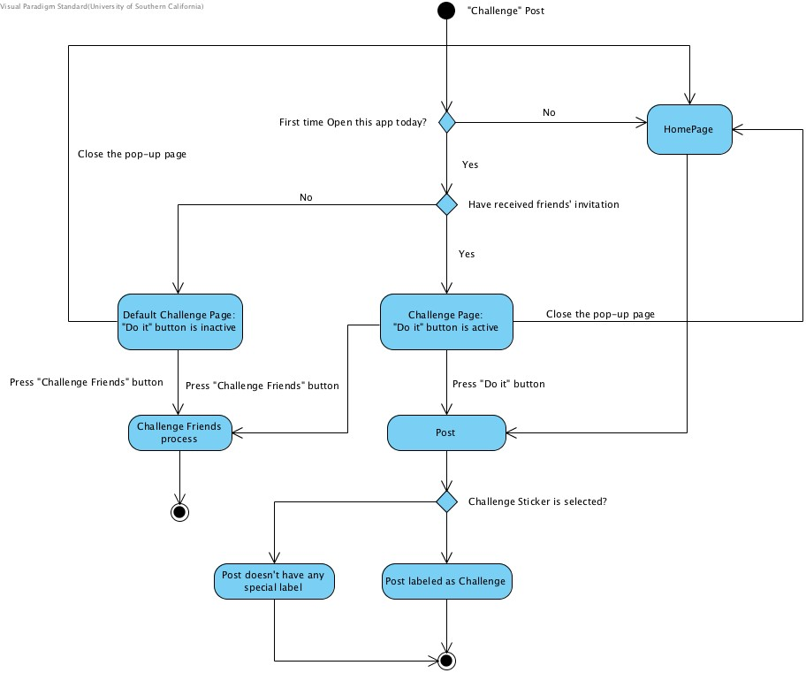

Slide 10
:.: Risk
Risk II: How can the application access a user contact list and Camera?
Privacy information is an external system
We were not sure whether it is possible for us to access user contact lists or Photo Library/Camera
We could not come up with an approach to sending text message

Slide 11
:.: Risk
Risk III: How can people check their friends’ posts?
For the first version of Prototype, we decided to add a new button in profile page which would segue you to the posts pages
After several negotiations, we don’t want to make our profile page more complicated so that we put it in the pop-up challenge page.

Slide 12
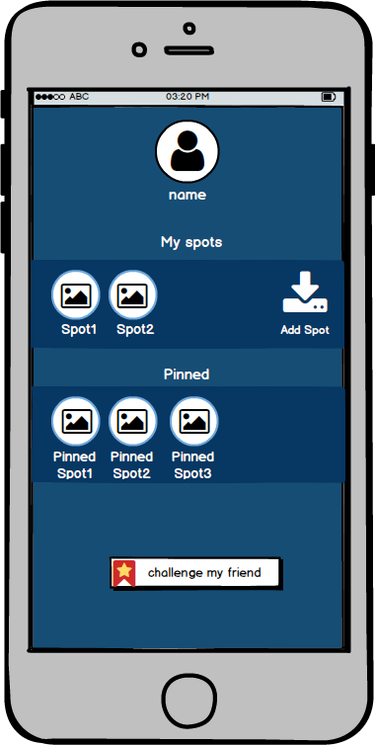
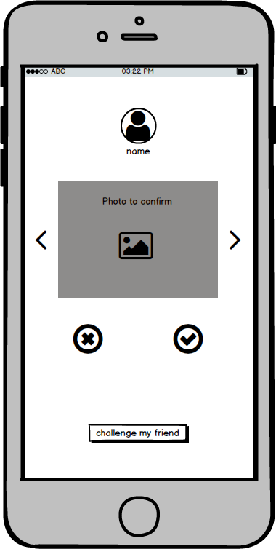
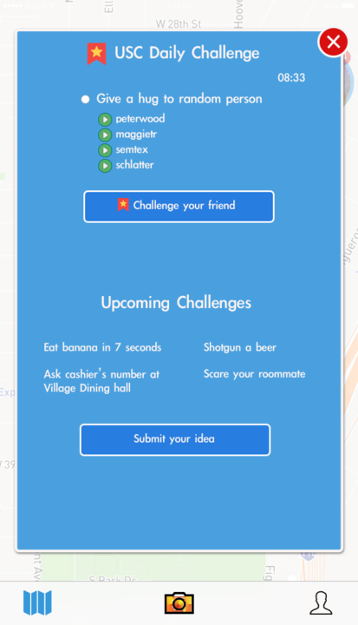
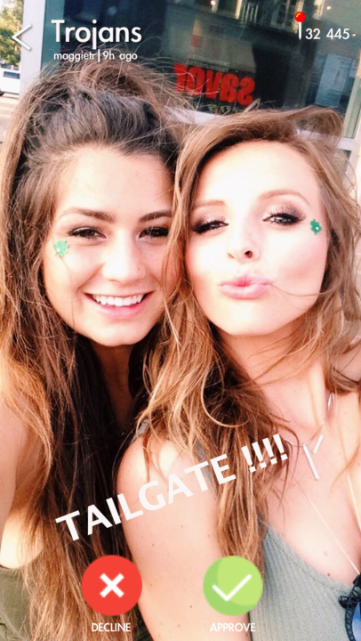
:.: Risk
Previous
Now

Slide 13
:-: More issues waits to be solved…

